Slide 1
Objected Oriented Programming Concepts Using C++ & Data Structures Session 2

Slide 2
Intro
Programming : giving instructions
Programming Paradigm : Way of Thinking
C++ : Programming Language that supports procedural and object-oriented.
Data Structures : Way of organizing data

Slide 3
Topics covered
Array
String & Streams
Properties
Access specifiers
Constructors and Destructors
Types of constructors & destructors
Static Member
Inline Function
Inheritance
Types of inheritance

Slide 4
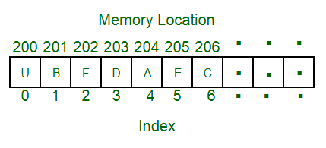
Array
Linear data structure
Elements are stored at contiguous memory locations.
Store multiple items of the same type together
Implementation :
int a[3 ];
a[0] = 2; cout<<”Value is”<<a[0]; // Value is 2
a[1] = 5 ; cout<<”Value is”<<a[1]; // Value is 5
a[2] = 6; cout<<”Value is”<<a[2]; // Value is 6

Slide 5
Strings & Streams
Collection of character
Group of zero or more number of character forms a string
Example : “Hello world”
Implementation in C++:
char str[20] = “Hello World”;

Slide 6
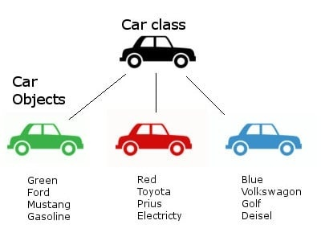
Properties of Class
Data Members
data variables
Member Functions
functions used to manipulate these variables

Slide 7
Access specifiers
define how the members of the class can be accessed
Specifiers | Class Boundary | Through Inhertiance | Through Objects
Private | Accessible | Not Accessible | Not Accessible
Protected | Accessible | Accessible | Not Accessible
Public | Accessible | Accessible | Accessible

Slide 8
Constructors
Special class functions which performs initialization of every object
Compiler calls the Constructor whenever an object is created.
Name of constructor will be same as the name of the class, and contructors will never have a return type.

Slide 9
Destructors
Special class function which destroys the object as soon as the scope of object ends.
The destructor is called automatically by the compiler when the object goes out of scope.

Slide 10
Types of Constructors
Default Constructor
the constructor which doesn't take any argument. It has no parameter.
A default constructor is so important for initialization of object members, that even if we do not define a constructor explicitly, the compiler will provide a default constructor implicitly.
Parametrized Constructor
constructors with parameter
can provide different values to data members of different objects, by passing the appropriate values as argument.
Copy Constructor
which takes an object as argument, and is used to copy values of data members of one object into other object

Slide 11
Static Member
It means no matter how many objects of the class are created, there is only one copy of the static member.
Static member is shared by all objects of the class.
Static Function Members :
Independent of any particular object of the class.
Can be called even if no objects of the class exist
Accessed using only the class name and the scope resolution operator ::
Static member function can only access static data member, other static member functions and any other functions from outside the class.

Slide 12
Inline Function
To reduce the function call overhead
When the inline function is called whole code of the inline function gets inserted or substituted at the point of inline function call.
This substitution is performed by the C++ compiler at compile time. Inline function may increase efficiency if it is small.

Slide 13
Inheritance
An object of class acquires the properties of another class.
Parent / Super class - whose properties can be inherited
Child / Sub class - who inherts the properties of class
achieves reusability
Implemented using operator ':' with access modifers [private , protected, public]

Slide 14
Example
class Person {
private int aadharNo;
protected char[] name;
protected char[] address;
public void showID()
}
class Teacher : public Person {
private int employeeNo ;
private char[] subjectsTaken;
private int experience;
public int getexpertiseSubject();
}
class Student : public Person {
private int rollNo ;
private char [] marks;
private float height;
private Attendences attendences;
public float calculatePercentage()
public int getAttendOfMonth(Month)
}

Slide 15
Mode of Inheritance
Base class member Access Specifier | Private | Protected | Public
private | Not Accessible | Not Accessible | Not Accessible
protected | private | protected | protected
public | private | protected | public

Slide 16
Types of Inheritance
Single Inheritance
one derived class inherits from only one base class.
Multiple Inheritance
single derived class may inherit from two or more than two base classes.
Hierarchical Inheritance
multiple derived classes inherits from a single base class.
Multilevel Inheritance
derived class inherits from a class, which in turn inherits from some other class. The Super class for one, is sub class for the other.
Hybrid Inheritance (also known as Virtual Inheritance)
combination of Hierarchical and Mutilevel Inheritance.

Slide 17
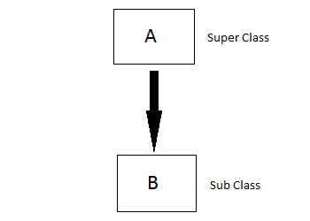
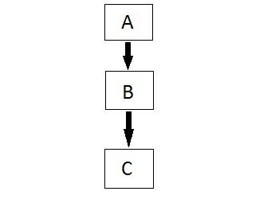
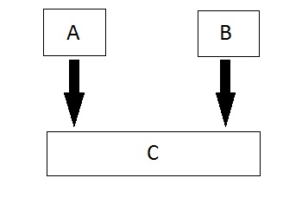
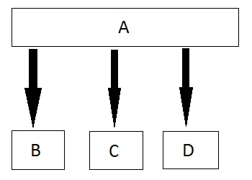
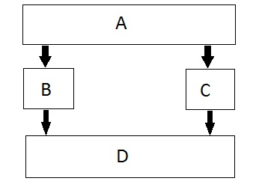
Types of Inheritance
Single
Multiple
Multilevel
Hierarchical
Hybrid

